Slide 1

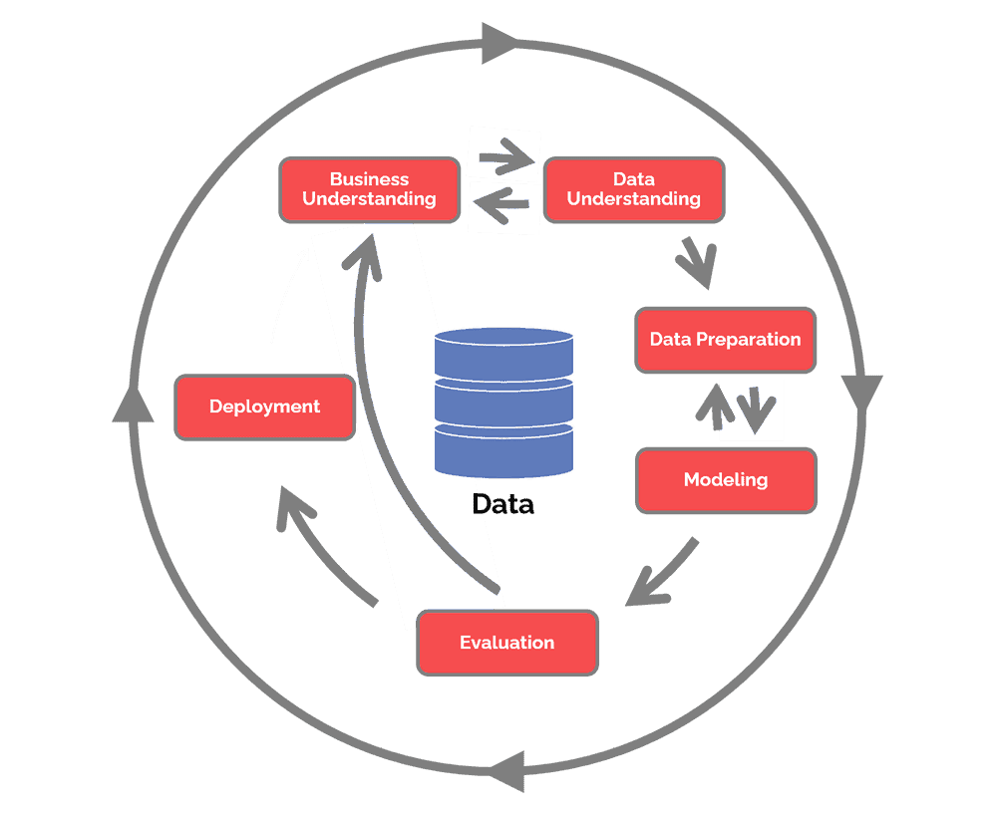
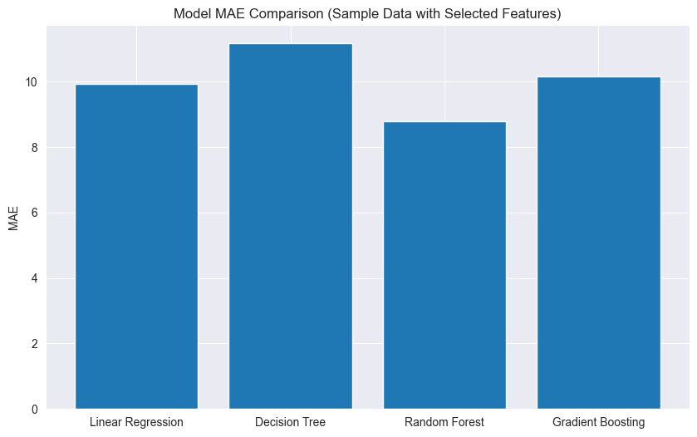
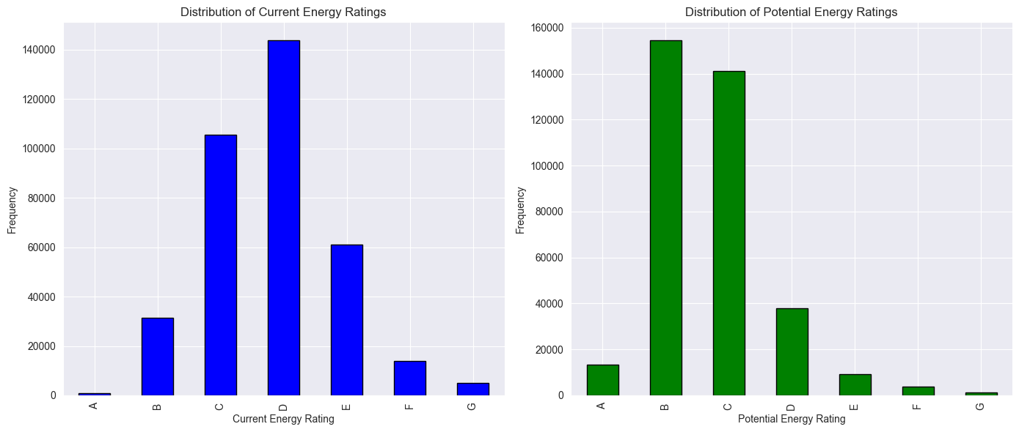
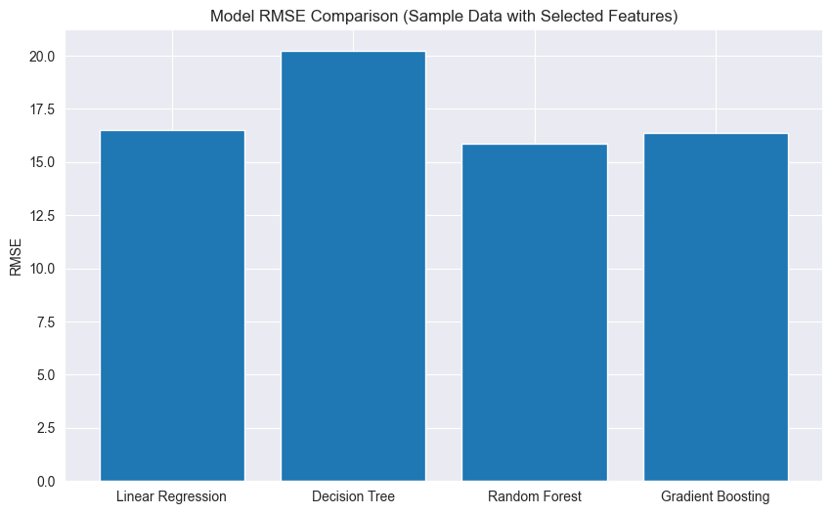
Comparison of Machine Learning Algorithms in Building Energy Consumption Prediction
Name: Kobina Folson
SCHOOL OF BUILT ENVIRONMENT, ENGINEERING AND COMPUTING
MSc Data Science
Supervisor: Hadeel Jazaa
OVERVIEW
RESEARCH OUTCOME AND DISCUSSION
Building energy efficiency is shown as a critical component of sustainable development in the context of expanding global energy consumption and environmental concerns. Population growth puts a burden on energy supplies, highlighting the necessity for careful energy management. This requires precise estimations of building energy use. Algorithms for machine learning (ML) are useful tools for understanding complex energy trends and guiding data-driven decisions. Recent developments show ML's capability to forecast building energy consumption, enabling better energy planning and cost-effective solutions. These algorithms use historical energy data, weather patterns, occupancy rates, building attributes, and relevant elements to assist energy optimisation, waste reduction, and improved sustainability. The graphs below show the current and potential energy ratings of buildings from the selected dataset of buildings based in Leeds.
METHODOLOGY
The study's conclusions addressing the use of several machine learning models to forecast building energy usage are presented in this chapter. By assessing the models' performance using mean absolute error (MAE) and root mean square error (RMSE) metrics, it seeks to give readers a thorough grasp of the models' efficacy and consequences.
The RMSE and MAE values for the Gradient Boosting, Decision Tree, Random Forest, and Linear Regression models are shown in graphs below. These numbers provide a comparison of the model's effectiveness:
This dissertation revolves around a methodology designed to facilitate a comprehensive comparative analysis of machine learning (ML) algorithms aimed at predicting building energy consumption. The methodology is intricately guided by the Cross-Industry Standard Process for Data Mining (CRISP-DM), which unfolds across six crucial stages.
To better understand systems and/or their processes, data mining (DM) refers to the process of looking for hidden patterns or relationships in data. These patterns could be used, for instance, to assess the degree of a relationship between variables or forecast future results (Gibert et al., 2018).
The research is guided by the CRISP methodology, which entails six stages: business comprehension, data preparation, modelling, assessment, and implementation. Business objectives, data gathering, cleaning, training, and deployment in real-world contexts are all covered. The research design uses a comparative analysis methodology to systematically evaluate different machine learning (ML) algorithms in order to decide which approach is optimal for forecasting building energy use. This method demonstrates the benefits and drawbacks of several energy forecasting systems.
The figure above shows the flow of the processes and their relationships. Using it as a guide enabled the successful implementation of the various techniques employed by the methodology to develop robust models, which allowed a proper comparison of their performance based on the metrics applied.
LITERATURE REVIEW
Predicting building energy consumption has been the subject of extensive research due to the rising demand for sustainable and energy-efficient practices. Modern developments in machine learning (ML) algorithms have opened up new possibilities to improve the precision and accuracy of energy consumption predictions, assisting in efficiently managing and optimising energy resources in buildings.
In "Building energy consumption prediction for residential buildings using deep learning and other machine learning techniques" (Olu-Ajayi et al., 2022), they employed various ML techniques, including Artificial Neural Network (ANN), Gradient Boosting (GB), Deep Neural Network (DNN), Random Forest (RF), Stacking, K Nearest Neighbour (KNN), Support Vector Machine (SVM), Decision tree (DT), and Linear Regression (LR), to predict annual building energy consumption using a large dataset of residential buildings. The study also examined how building clusters influence the performance of these models. The novelty lies in developing a model that allows designers to input key building design features and predict annual energy consumption during early development stages.
As a result of the urgent demand for sustainable and energy-efficient practices, it is vital to forecast building energy use, which has sparked substantial research efforts. Utilising improvements in machine learning (ML) techniques, this study area has made significant strides, providing ways to improve the precision and accuracy of estimates of energy usage. These contemporary methods, also used in this dissertation, have become potent tools for managing and optimising energy resources within buildings, advancing the objectives of environmental protection and effective energy use.
CONCLUSION
This dissertation study thoroughly examined the performance of decision trees, linear regression, random forest, and gradient-boosting algorithms in predicting building energy use. Through careful analysis, it became clear that the random forest method excelled over the competition, continuously displaying reduced Mean Absolute Error (MAE) and Root Mean Square Error (RMSE) values. Its capacity to efficiently capture complex data linkages can be credited with this higher predicted accuracy. The study, however, also emphasised the contextual element of algorithm selection, highlighting that the unique properties of buildings and datasets play a crucial role in determining algorithm performance.
The results of this study provide helpful information for both practitioners and academics working on energy-efficient building management. Stakeholders can make well-informed choices that result in more precise projections of energy usage by realising the dominance of the random forest algorithm and the significance of adapting options to the particular aspects of each situation. This study improves our knowledge of machine learning related to energy forecasting. Enhancing building energy management techniques opens the path for a cleaner future.
AIM AND OBJECTIVES
The study's main aim is to analyse and assess several machine learning (ML) algorithms for forecasting building energy use. The precise objectives of this investigation include the following critical actions:
Conducting a comprehensive assessment of existing ML techniques through a thorough literature review to gauge their effectiveness in estimating building energy consumption.
Finding and preparing data from trusted sources and performing the needed data pre-processing, including handling missing values, outliers, and feature scaling, ensures dataset readiness for ML model training.
Selecting and Implementing appropriate ML algorithms and training them using the prepared dataset, optimising models, and fine-tuning hyperparameters to yield optimal results.
Evaluating the performance of the ML algorithms using metrics such as Mean Absolute Error (MAE), Root Mean Squared Error (RMSE) and considering model interpretability and computational efficiency.
Analysing the advantages and limitations of each ML approach for predicting building energy, facilitating informed decision-making by comprehending their strengths and weaknesses.
REFERENCES
Gibert, K., Izquierdo, J., Sànchez-Marrè, M., Hamilton, S. H., Rodríguez-Roda, I. & Holmes, G. (2018) Which Method to Use? An Assessment of Data Mining Methods in Environmental Data Science. Environmental Modelling & Software, 110 December, pp. 3–27.
Olu-Ajayi, R., Alaka, H., Sulaimon, I., Sunmola, F. & Ajayi, S. (2022) Building Energy Consumption Prediction for Residential Buildings Using Deep Learning and Other Machine Learning Techniques. Journal of Building Engineering, 45 January, p. 103406.

Slide 2
URLs
Presentation:
Meeting with Folson, Kobina (Student)-20230907_194805-Meeting Recording.mp4
Product:
https://github.com/kobfolson/building-energy-prediction.git
Data:
https://drive.google.com/file/d/1qmfnSTE3LoFkyEgW5EOsEQJJm6SrvADg/view?usp=sharing

